Slide 1

Developing Data Products and Computational Techniques to Improve the Targeting and MEL of Humanitarian, Development and Conservation Interventions
Chris Barrett
Guest Lecture to CS 6702
Computational Sustainability
September 7, 2022

Slide 2
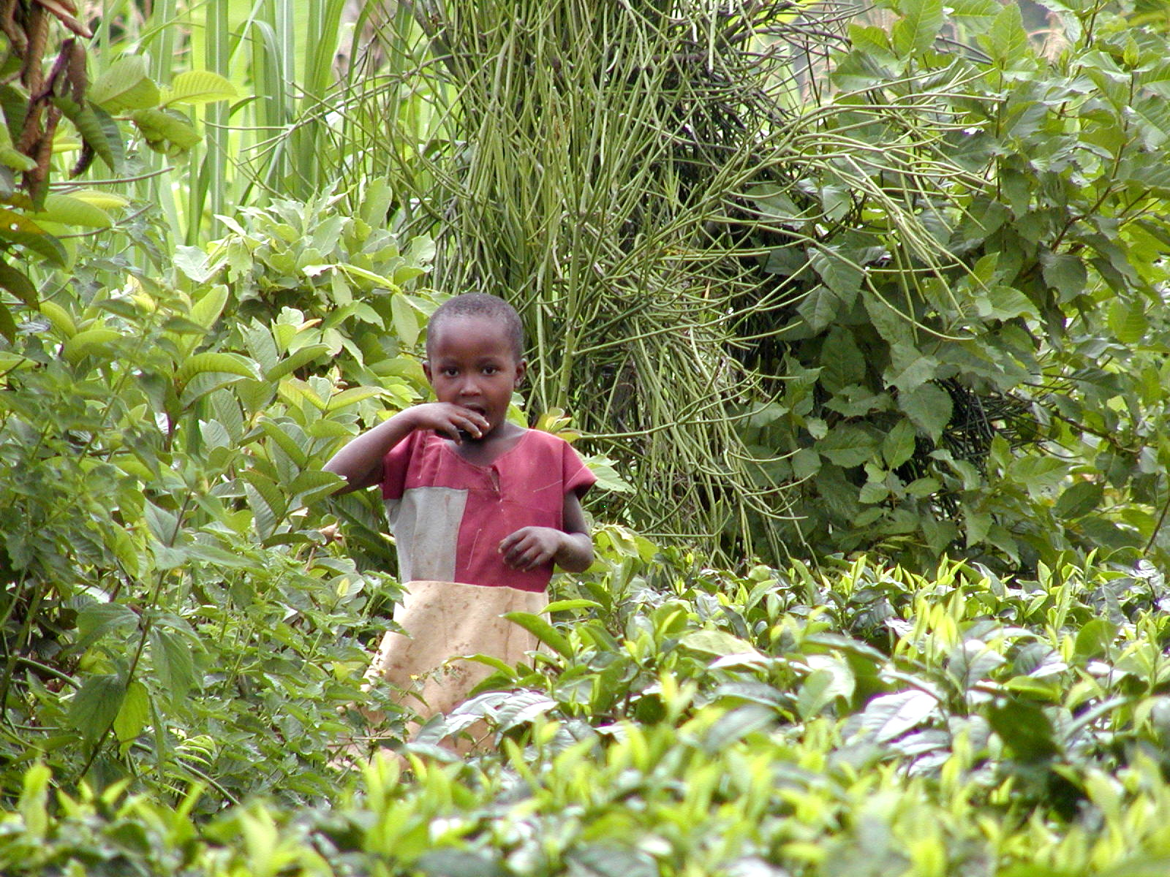
“Most of the people in the world are poor, so if we knew the economics of being poor we would know much of the economics that really matters.”
- Theodore W. Schultz
Opening sentences of 1979 Nobel Prize in Economics lecture
Better economics to reduce poverty and malnutrition requires improved data collection and analysis.

Slide 3
The challenge
Renewed interest and funding for interventions targeted toward hunger and poverty reduction.
Increased flexibility in instruments (e.g., no longer just food aid shipments in response to emergencies).
Rapid growth in open access data availability.
Need to translate more dollars and data into better choices, now that there more choices are available.
Need to know:
  who is poor/hungry and how to identify them?
  what is best response to help them?
Emerging computational challenges/opportunities.

Slide 4

Recent USAID Project
Recent USAID project
http://barrett.dyson.cornell.edu/research/innovations.html

Slide 5
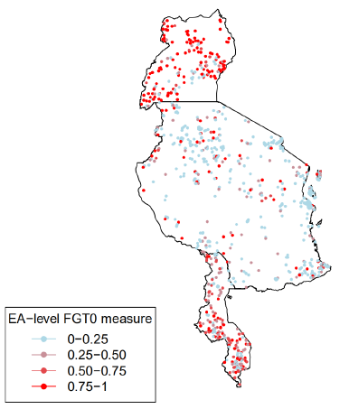
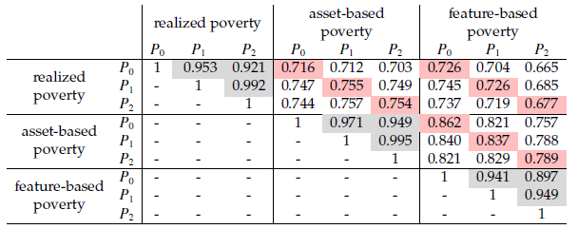
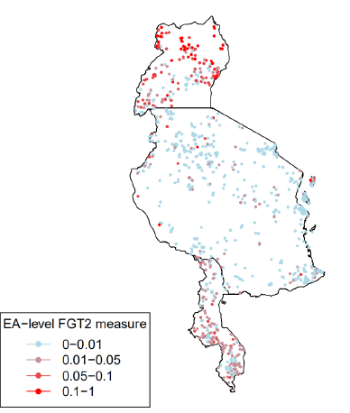
Poverty maps for geographic targeting
Identifying where the poor live is 1st step
Poverty maps:
Use multiple data sets to estimate and map structural poverty. That’s what one targets.
ML methods and EO data permit projection into unsampled spaces and time periods.
Collaborate w/World Bank, TNC, CI, WWF, NCP

Slide 6
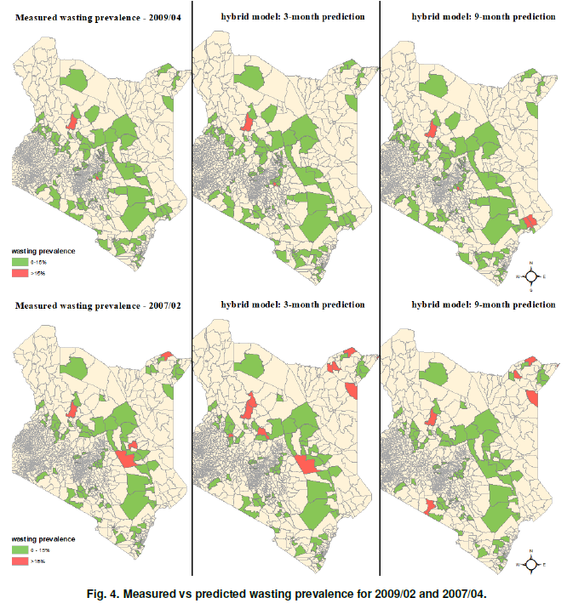
Nowcasting/forecasting
Targeting
Early warning: where are needs now or in future?
Work w/Kenya’s NDMA –
Early warning system
to limit MAM/SAM,
esp. among children.
Use their sentinel site:
monthly survey data,
2006-20 (~90 wards,
~3 mn child obs.)
Gradient boosted random
forests
(extensions: spatial hetero/
dependence)

Slide 7
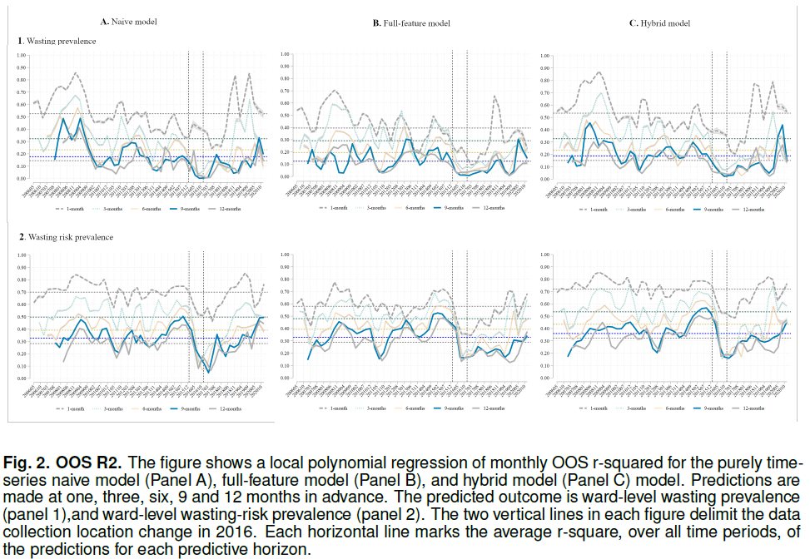
Nowcasting/forecasting
Targeting
Can we generate forecasts of sufficient accuracy?

Slide 8
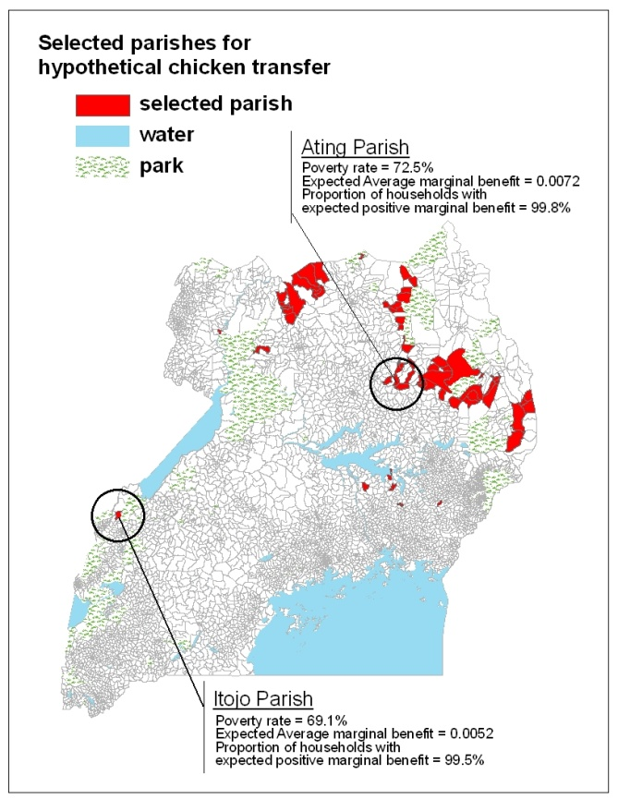
Beyond where:
targeting intervention type
Targeting
Choosing the right tool, place and people:
Targeting maps (Lang et al. WD 2013)

Slide 9
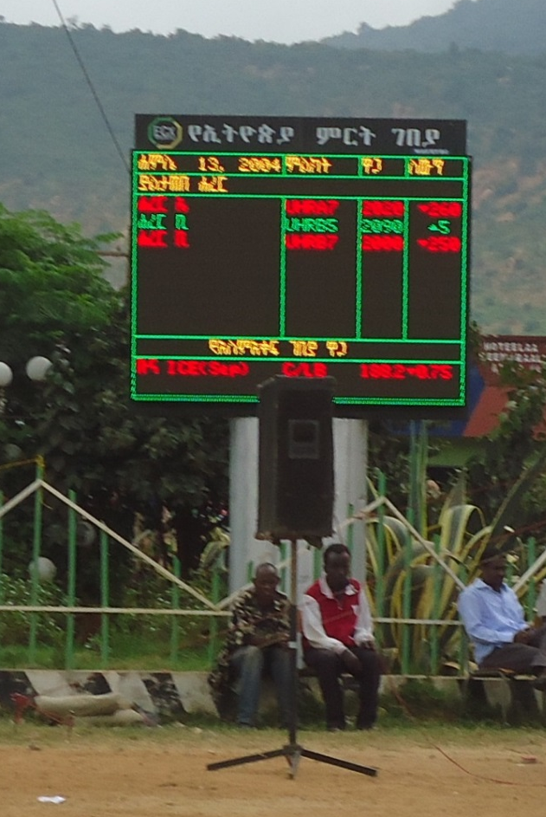
Questions?
Thank you for your interest. If you’re interested in working on these problems, please contact Chris Barrett (cbb2) or Liz Tennant (ejt58)

